Slide 1
COT5615: Math for Intelligent Systems I
Anand Rangarajan
Lecture 23

Slide 2
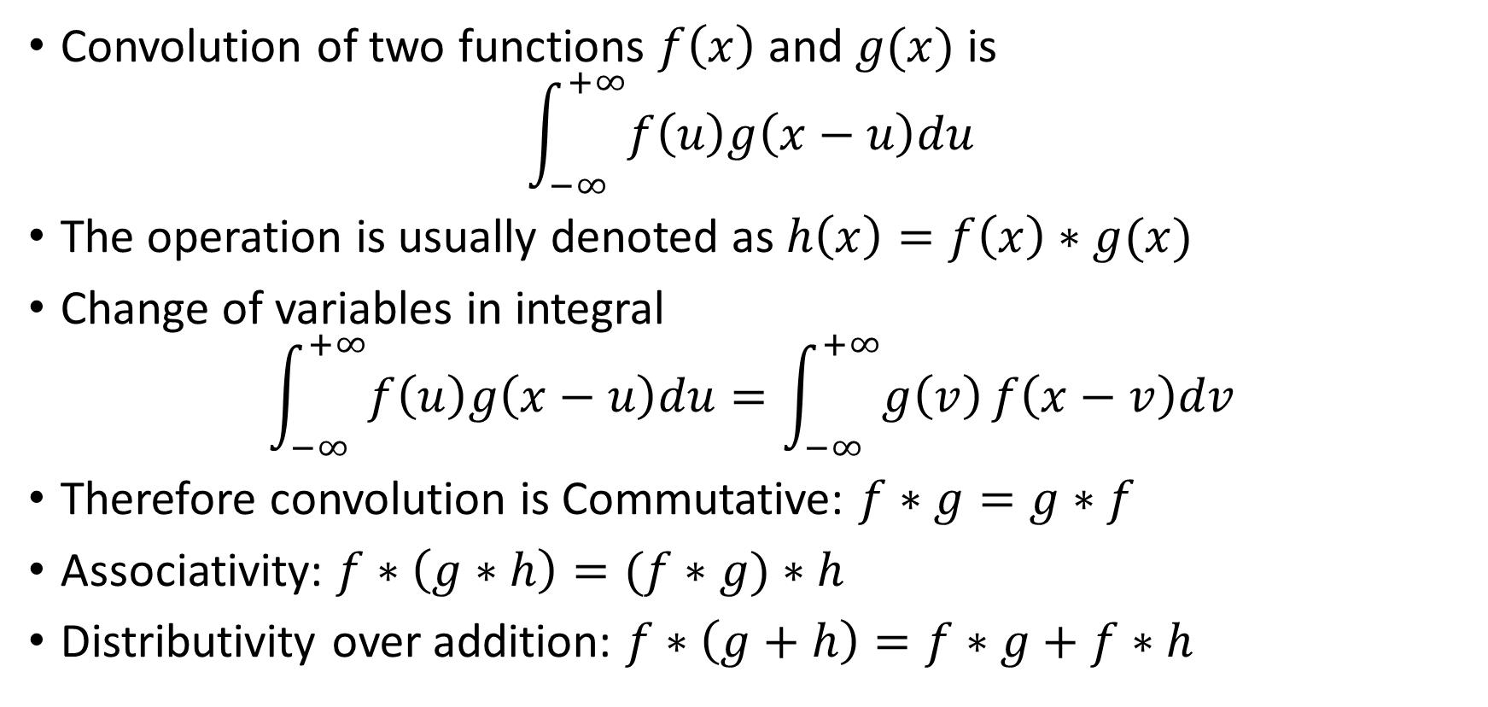
The Convolution Integral
Convolution of two functions $f\left(x\right)$ and $g(x)$ is
$$\int_{−∞}^{+∞}{f\left(u\right)g\left(x−u\right)du}$$
The operation is usually denoted as $h\left(x\right)=f\left(x\right)∗g(x)$
Change of variables in integral
$$\int_{−∞}^{+∞}{f\left(u\right)g\left(x−u\right)du}=\int_{−∞}^{+∞}{g\left(v\right)}f\left(x−v\right)dv$$
Therefore convolution is Commutative: $f∗g=g∗f$
Associativity: $f∗\left(g∗h\right)=(f∗g)∗h$
Distributivity over addition: $f∗\left(g+h\right)=f∗g+f∗h$

Slide 3
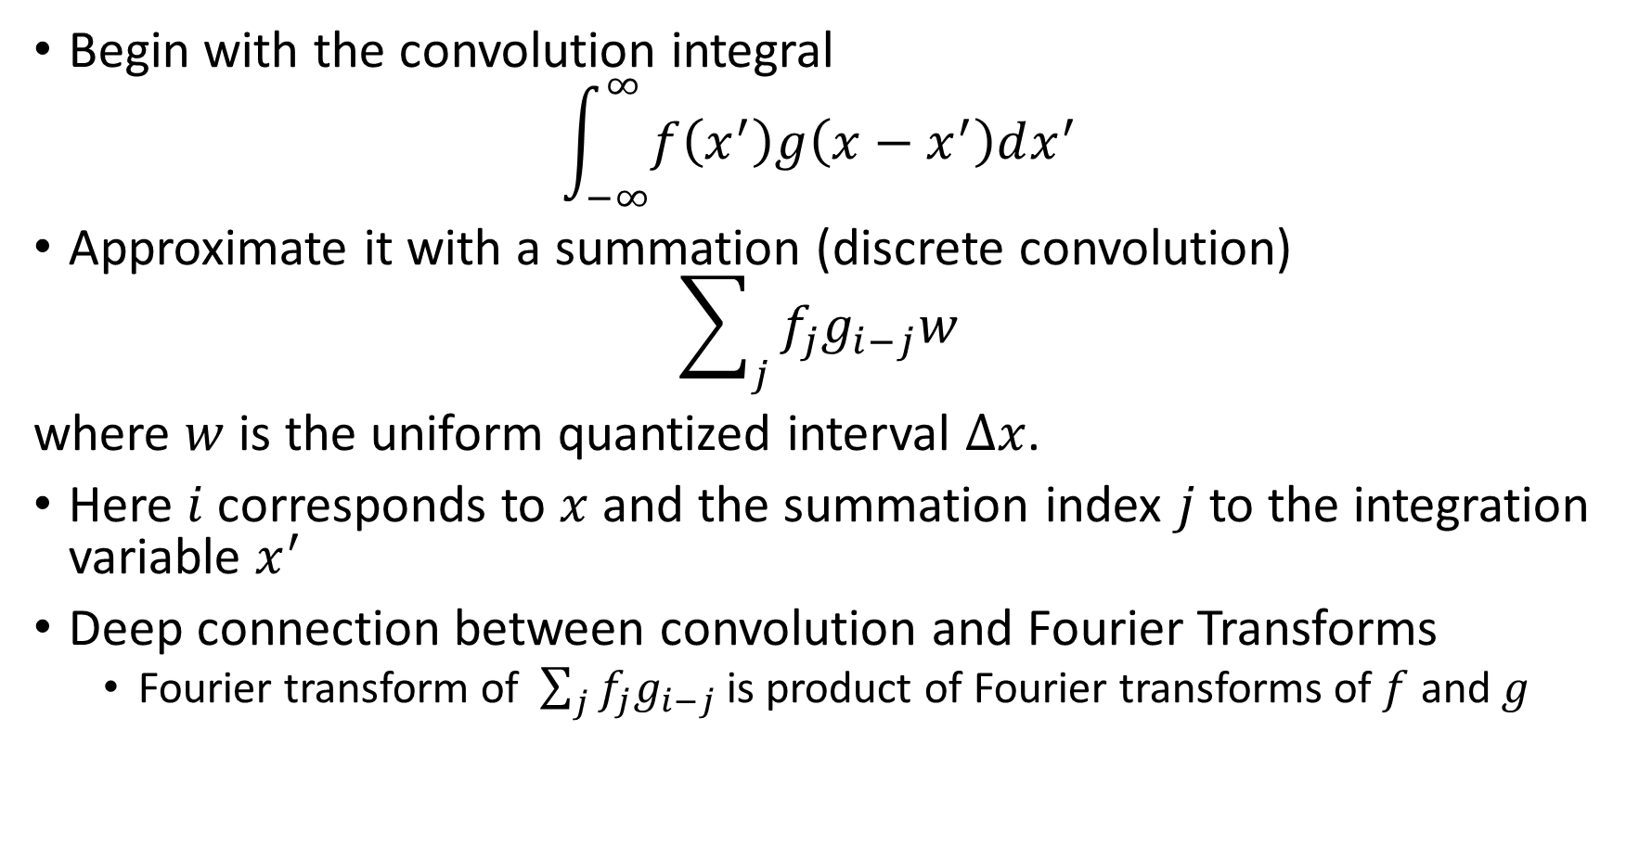
Approximating the convolution integral
Begin with the convolution integral
$$\int_{−∞}^{∞}{f\left(x^{′}\right)g\left(x−x^{′}\right)dx^{′}}$$
Approximate it with a summation (discrete convolution)
$$\sum_{j}{f_{j}g_{i−j}w}$$
where $w$ is the uniform quantized interval $Δx$.
Here $i$ corresponds to $x$ and the summation index $j$ to the integration variable $x^{′}$
Deep connection between convolution and Fourier Transforms
Fourier transform of $\sum_{j}{f_{j}g_{i−j}}$ is product of Fourier transforms of $f$ and $g$

Slide 4
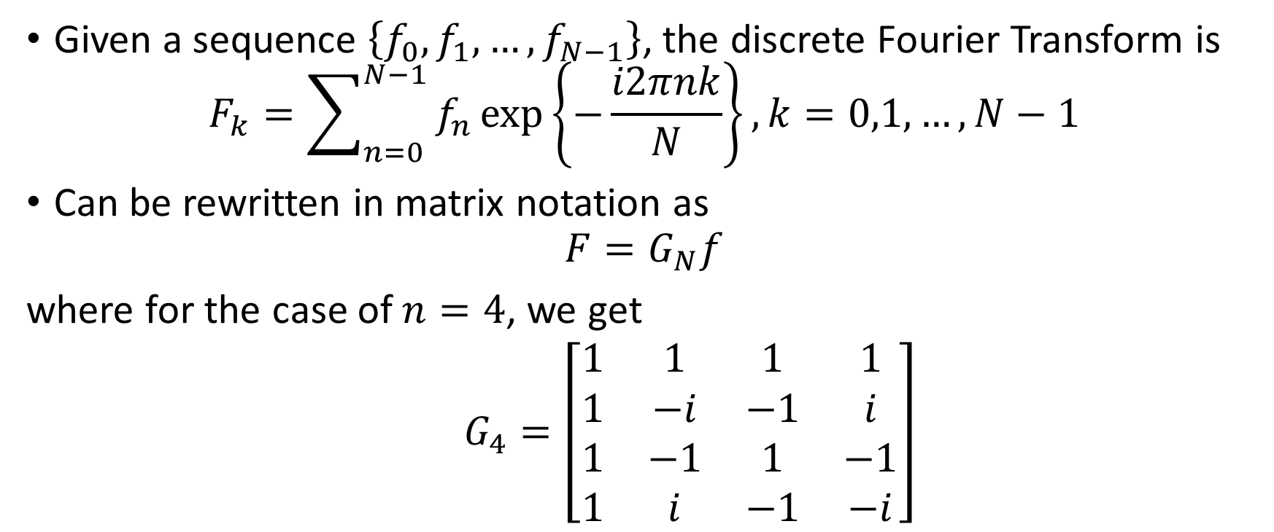
The Discrete Fourier Transform
Given a sequence $\left\{f_{0},f_{1},…,f_{N−1}\right\}$, the discrete Fourier Transform is
$$F_{k}=\sum_{n=0}^{N−1}{f_{n}\exp\left\{−\frac{i2πnk}{N}\right\}}, k=0,1,…,N−1$$
Can be rewritten in matrix notation as
$$F=G_{N}f$$
where for the case of $n=4$, we get
$G_{4}=\left[\begin{matrix}1 & 1 & 1 & 1 \\ 1 & −i & −1 & i \\ 1 & −1 & 1 & −1 \\ 1 & i & −1 & −i\end{matrix}\right]$

Slide 5
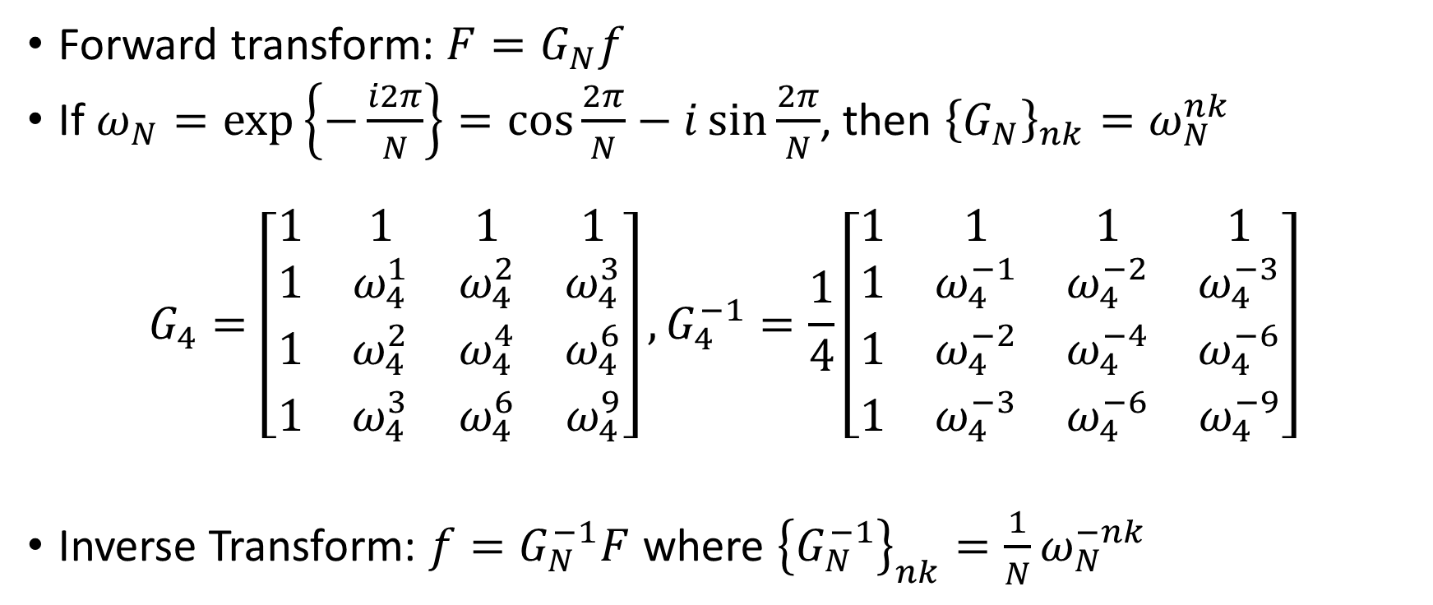
The Inverse Discrete Fourier Transform
Forward transform: $F=G_{N}f$
If $ω_{N}=\exp\left\{−\frac{i2π}{N}\right\}=\cos{\frac{2π}{N}}−i\sin{\frac{2π}{N}}$, then ${\left\{G_{N}\right\}}_{nk}=ω_{N}^{nk}$
$$G_{4}=\left[\begin{matrix}1 & 1 & 1 & 1 \\ 1 & ω_{4}^{1} & ω_{4}^{2} & ω_{4}^{3} \\ 1 & ω_{4}^{2} & ω_{4}^{4} & ω_{4}^{6} \\ 1 & ω_{4}^{3} & ω_{4}^{6} & ω_{4}^{9}\end{matrix}\right], G_{4}^{−1}=\frac{1}{4}\left[\begin{matrix}1 & 1 & 1 & 1 \\ 1 & ω_{4}^{−1} & ω_{4}^{−2} & ω_{4}^{−3} \\ 1 & ω_{4}^{−2} & ω_{4}^{−4} & ω_{4}^{−6} \\ 1 & ω_{4}^{−3} & ω_{4}^{−6} & ω_{4}^{−9}\end{matrix}\right]$$
Inverse Transform: $f=G_{N}^{−1}F$ where ${\left\{G_{N}^{−1}\right\}}_{nk}=\frac{1}{N}ω_{N}^{−nk}$

Slide 6
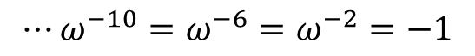
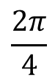
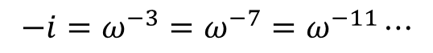

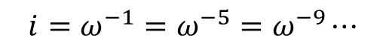
The Unit Circle in the Complex Plane
$$i=ω^{−1}=ω^{−5}=ω^{−9}⋯$$
$$\frac{2π}{4}$$
$$⋯ω^{−10}=ω^{−6}=ω^{−2}=−1$$
$$1=ω^{0}=ω^{−4}=ω^{−8}⋯$$
$$−i=ω^{−3}=ω^{−7}=ω^{−11}⋯$$
Roots of unity $ω_{N}^{k}=\exp\left\{\frac{−i2πk}{N}\right\}$ in the complex plane for $n=4$

Slide 7
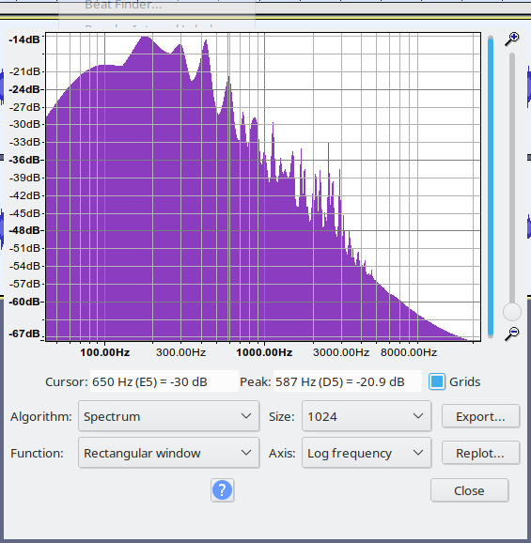

Audio Processing
Song Fragment
Log spectrum plot using audacity

Slide 8
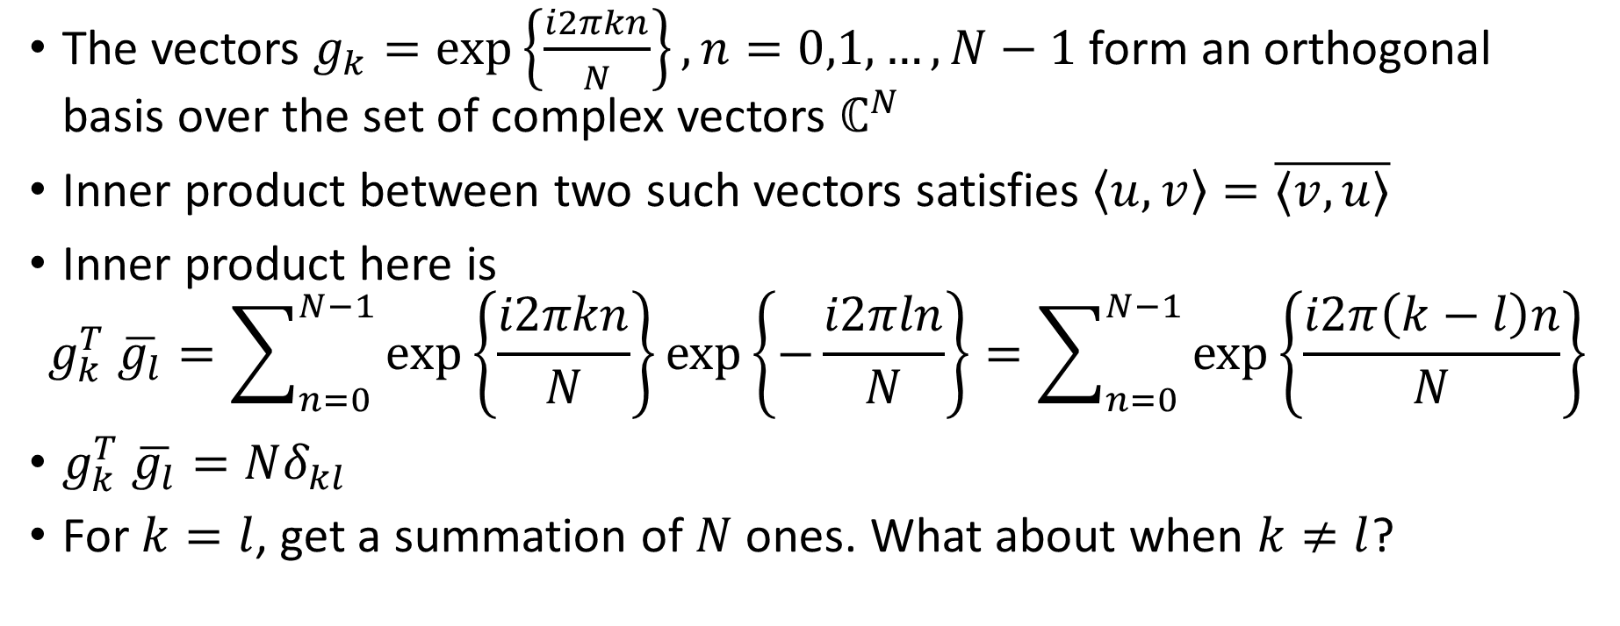
Orthogonality
The vectors $g_{k}=\exp\left\{\frac{i2πkn}{N}\right\},n=0,1,…,N−1$ form an orthogonal basis over the set of complex vectors $ℂ^{N}$
Inner product between two such vectors satisfies $\left\langle u,v\right\rangle =\overline{⟨v,u⟩}$
Inner product here is
$$g_{k}^{T} \overline{g_{l}}=\sum_{n=0}^{N−1}{\exp\left\{\frac{i2πkn}{N}\right\}\exp\left\{−\frac{i2πln}{N}\right\}=\sum_{n=0}^{N−1}{\exp\left\{\frac{i2π\left(k−l\right)n}{N}\right\}}}$$
$g_{k}^{T} \overline{g_{l}}=Nδ_{kl}$
For $k=l$, get a summation of $N$ ones. What about when $k≠l$?

Slide 9
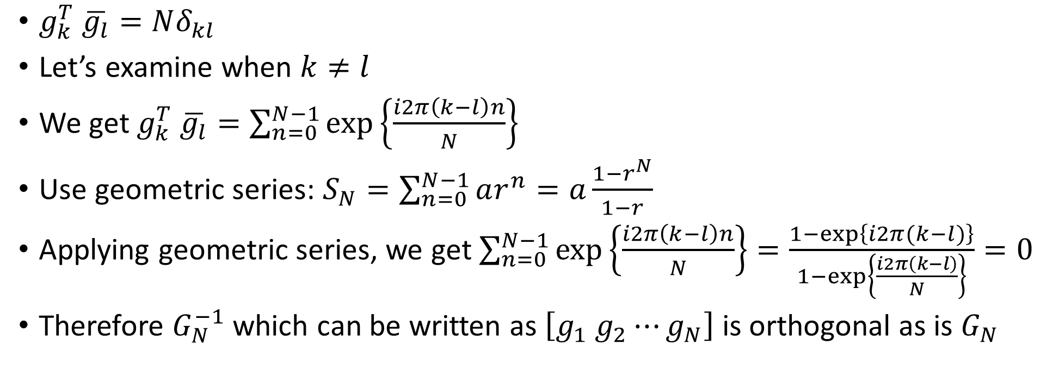
Orthogonality (contd.)
$g_{k}^{T} \overline{g_{l}}=Nδ_{kl}$
Let’s examine when $k≠l$
We get $g_{k}^{T} \overline{g_{l}}=\sum_{n=0}^{N−1}{\exp\left\{\frac{i2π\left(k−l\right)n}{N}\right\}}$
Use geometric series: $S_{N}=\sum_{n=0}^{N−1}{ar^{n}}=a\frac{1−r^{N}}{1−r}$
Applying geometric series, we get $\sum_{n=0}^{N−1}{\exp\left\{\frac{i2π\left(k−l\right)n}{N}\right\}}=\frac{1−\exp\left\{i2π(k−l)\right\}}{1−\exp\left\{\frac{i2π\left(k−l\right)}{N}\right\}}=0$
Therefore $G_{N}^{−1}$ which can be written as $\left[g_{1} g_{2}⋯g_{N}\right]$ is orthogonal as is $G_{N}$

Slide 10
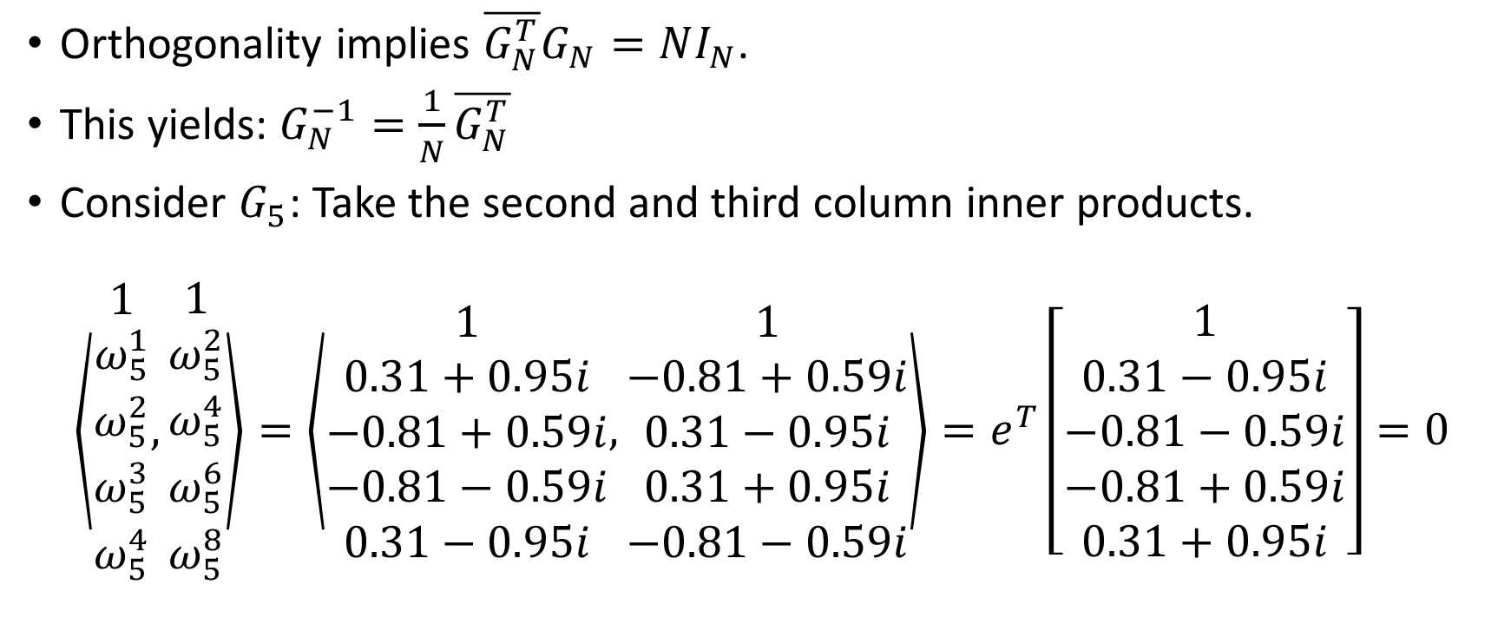
Orthogonality (fini)
Orthogonality implies $\overline{G_{N}^{T}}G_{N}=NI_{N}$.
This yields: $G_{N}^{−1}=\frac{1}{N}\overline{G_{N}^{T}}$
Consider $G_{5}$: Take the second and third column inner products.
$$\left\langle \begin{matrix}1 \\ ω_{5}^{1} \\ ω_{5}^{2} \\ ω_{5}^{3} \\ ω_{5}^{4}\end{matrix},\begin{matrix}1 \\ ω_{5}^{2} \\ ω_{5}^{4} \\ ω_{5}^{6} \\ ω_{5}^{8}\end{matrix}\right\rangle =\left\langle \begin{matrix}1 \\ 0.31+0.95i \\ −0.81+0.59i \\ −0.81−0.59i \\ 0.31−0.95i\end{matrix},\begin{matrix}1 \\ −0.81+0.59i \\ 0.31−0.95i \\ 0.31+0.95i \\ −0.81−0.59i\end{matrix}\right\rangle =e^{T}\left[\begin{matrix}1 \\ 0.31−0.95i \\ −0.81−0.59i \\ −0.81+0.59i \\ 0.31+0.95i\end{matrix}\right]=0$$

Slide 11
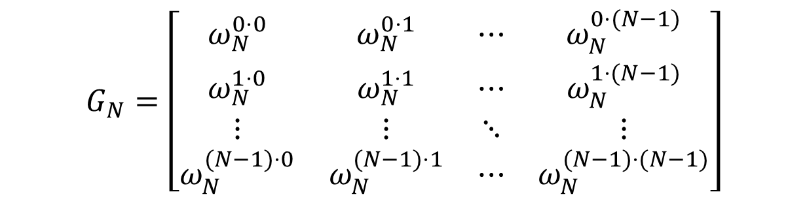



The Fourier Transform Matrix $G_{N}$
$$G_{N}=\left[\begin{matrix}ω_{N}^{0⋅0} & ω_{N}^{0⋅1} & ⋯ & ω_{N}^{0⋅(N−1)} \\ ω_{N}^{1⋅0} & ω_{N}^{1⋅1} & ⋯ & ω_{N}^{1⋅(N−1)} \\ ⋮ & ⋮ & ⋱ & ⋮ \\ ω_{N}^{(N−1)⋅0} & ω_{N}^{(N−1)⋅1} & ⋯ & ω_{N}^{(N−1)⋅(N−1)}\end{matrix}\right]$$
$$ω_{N}=\exp\left\{−\frac{i2π}{N}\right\}$$
$G_{N}$ is complex and symmetric (NOT HERMITIAN). ${\left\{G_{N}\right\}}_{kl}={\left\{G_{N}\right\}}_{lk}$
Therefore $G_{N}^{−1}=\frac{1}{N}\overline{G_{N}^{T}}=\frac{1}{N}\overline{G_{N}}$

Slide 12
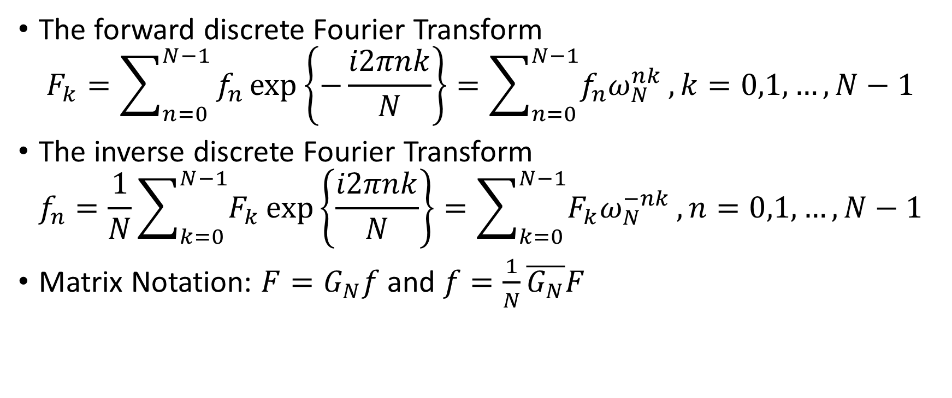
Summary
The forward discrete Fourier Transform
$$F_{k}=\sum_{n=0}^{N−1}{f_{n}\exp\left\{−\frac{i2πnk}{N}\right\}}=\sum_{n=0}^{N−1}{f_{n}ω_{N}^{nk}},k=0,1,…,N−1$$
The inverse discrete Fourier Transform
$$f_{n}=\frac{1}{N}\sum_{k=0}^{N−1}{F_{k}}\exp\left\{\frac{i2πnk}{N}\right\}=\sum_{k=0}^{N−1}{F_{k}ω_{N}^{−nk}},n=0,1,…,N−1$$
Matrix Notation: $F=G_{N}f$ and $f=\frac{1}{N}\overline{G_{N}}F$
But, what does this have to do with convolution?

Slide 13
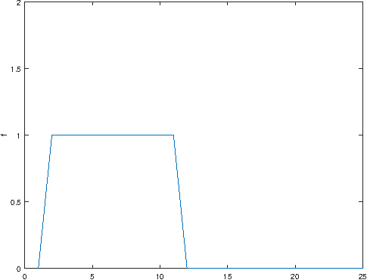
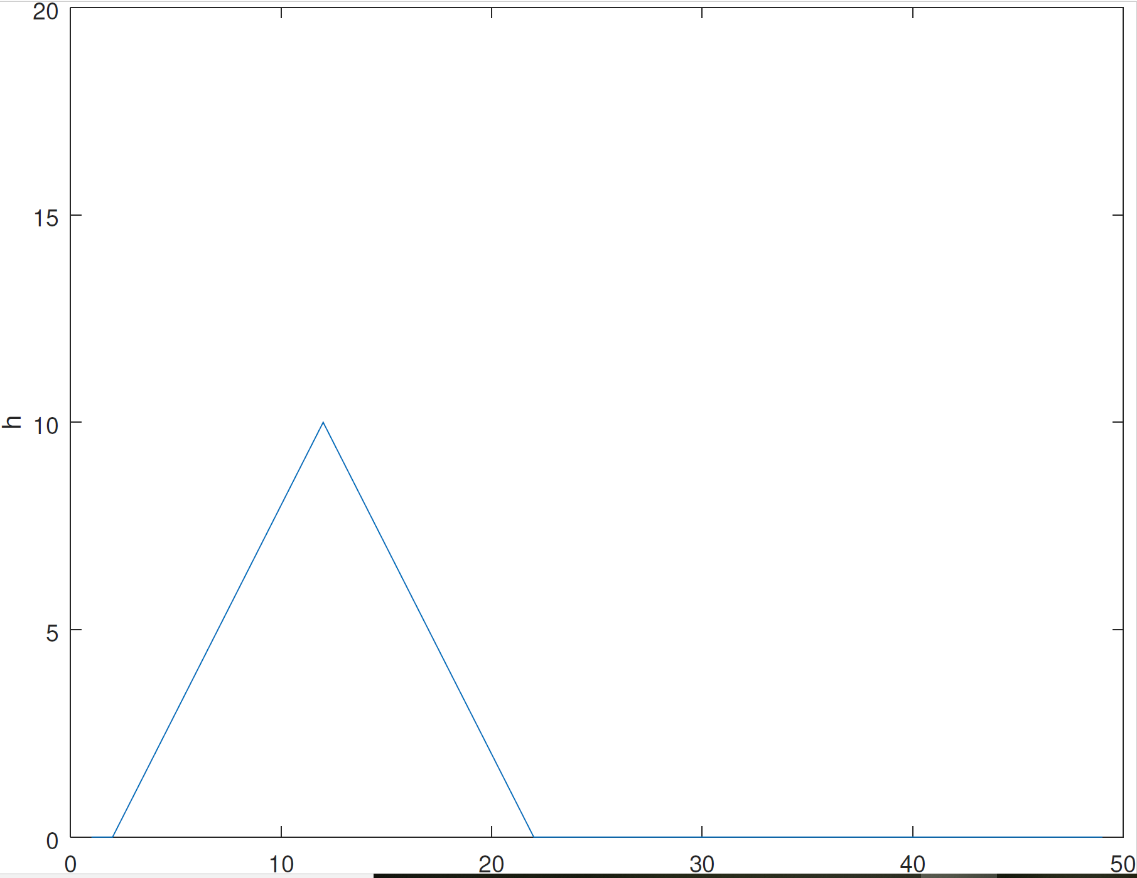
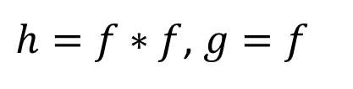
Convolution and Discrete Fourier Transform
$h=f∗f$, $g=f$

Slide 14
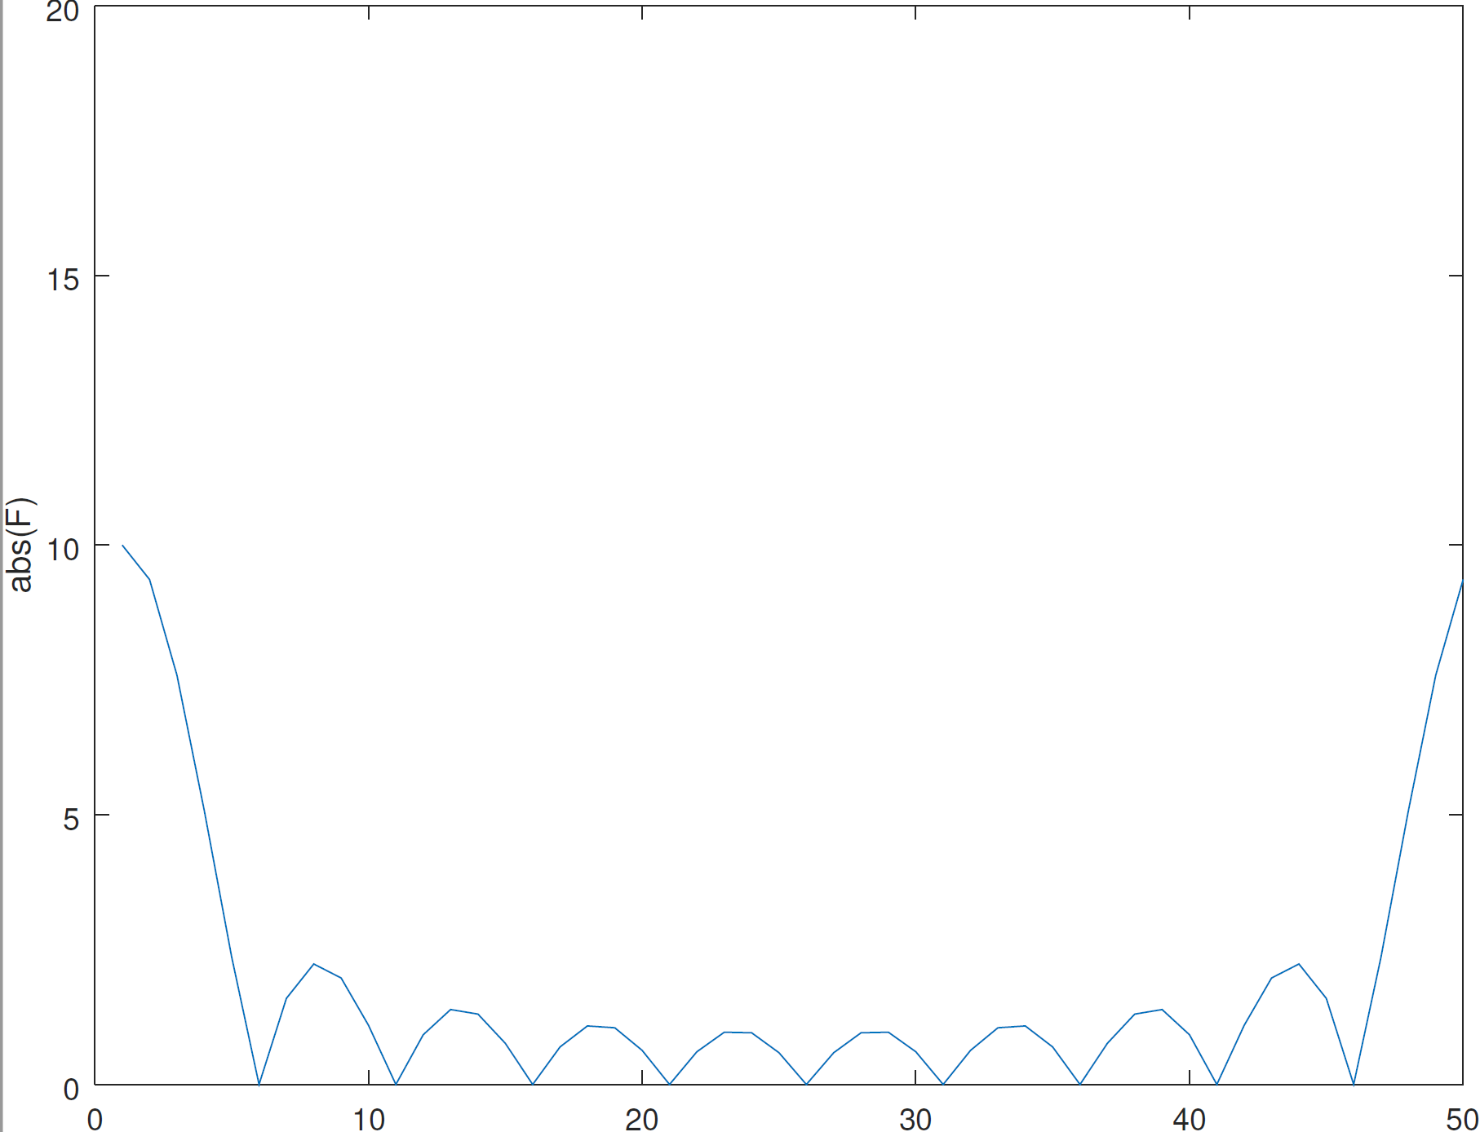
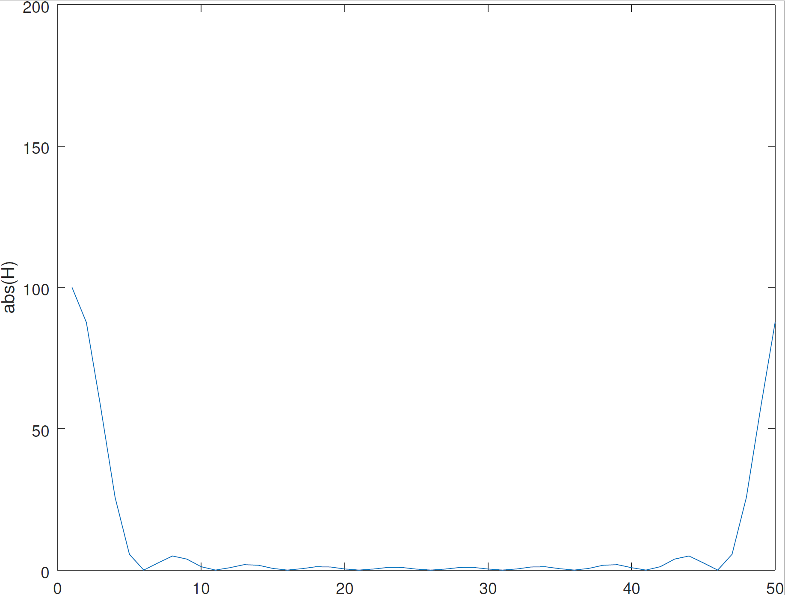
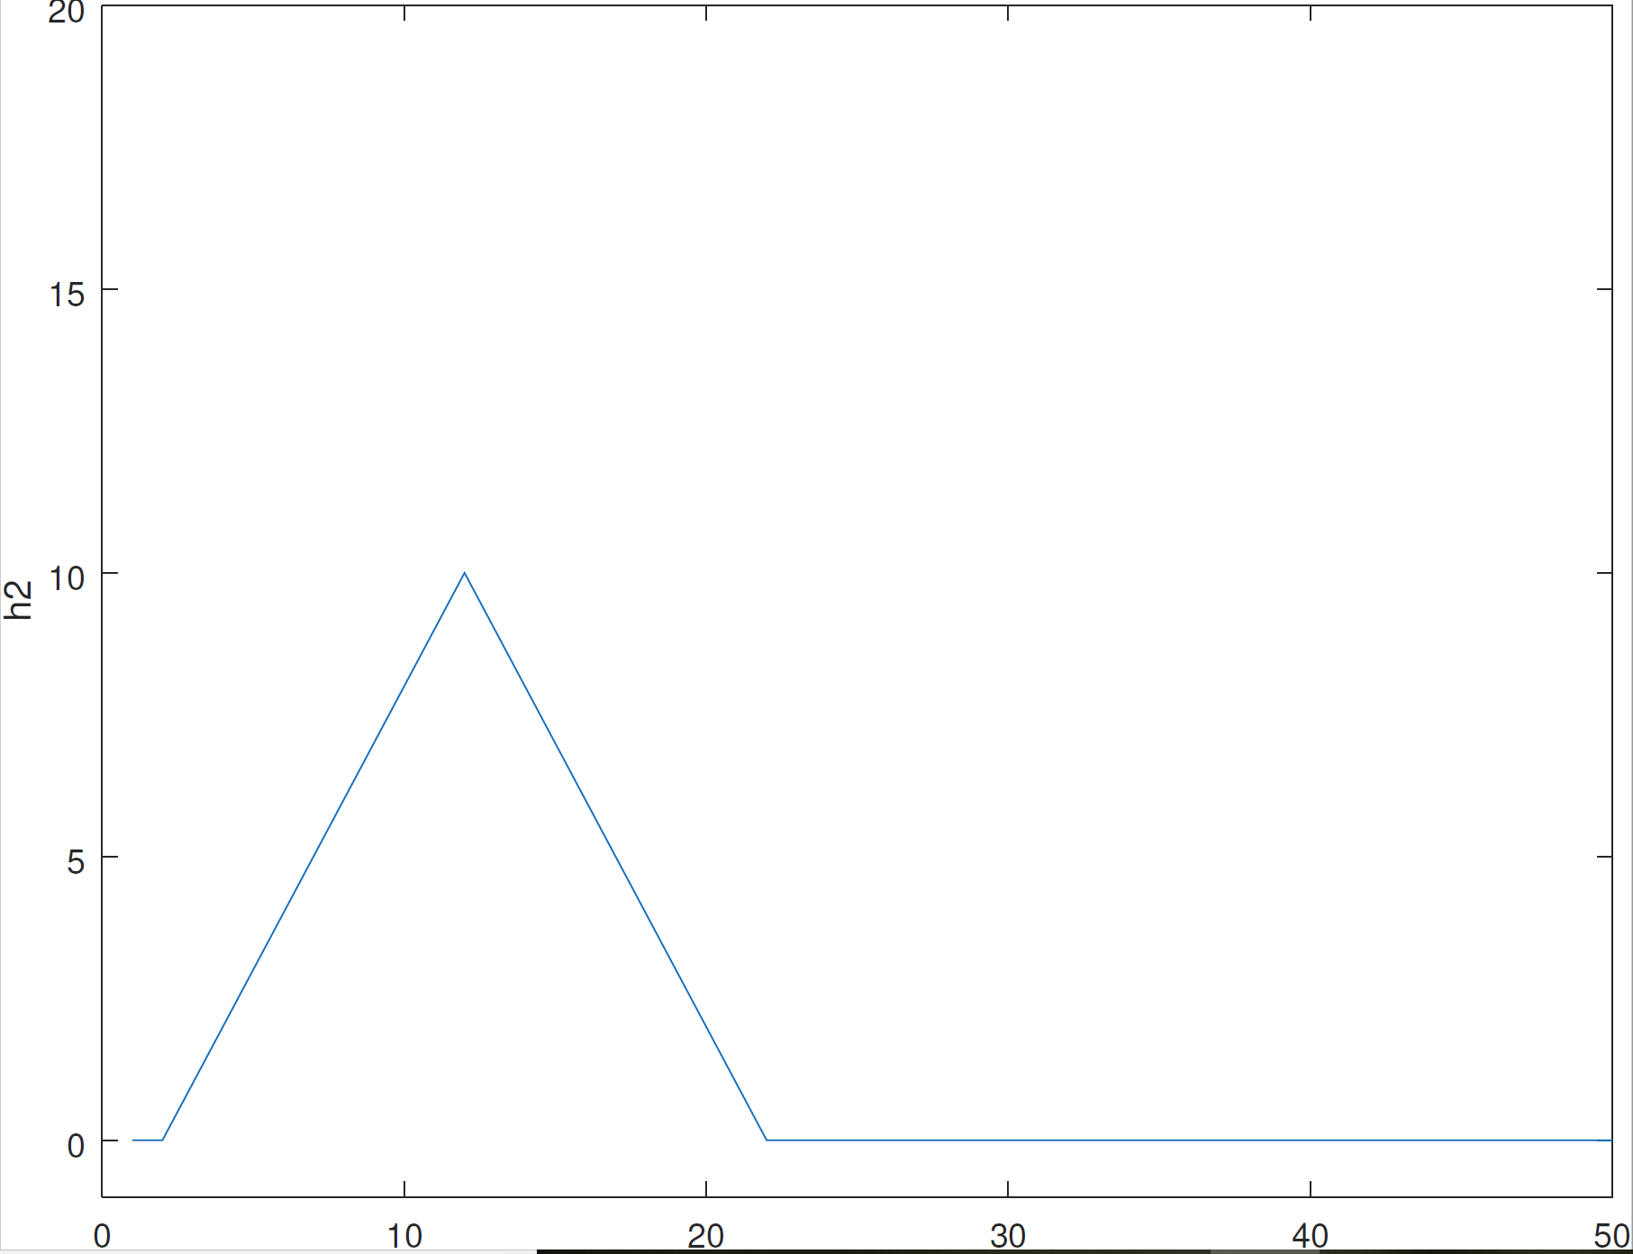

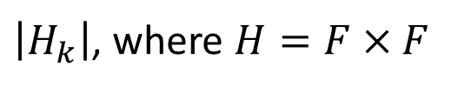

Convolution and Discrete Fourier Transform (contd.)
$$h=IFFT(H)$$
$$\left|F_{k}\right|$$
$\left|H_{k}\right|$, where $H=F×F$

Slide 15
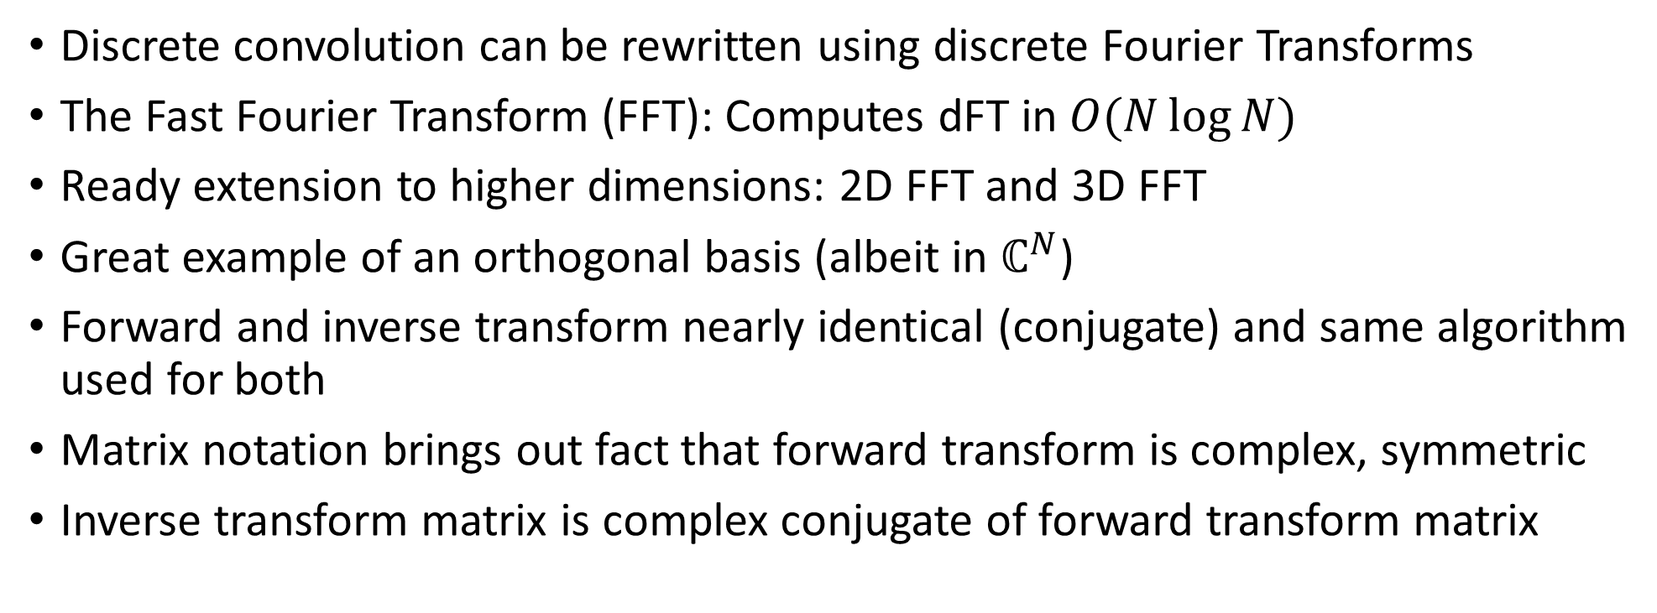
Applications
Discrete convolution can be rewritten using discrete Fourier Transforms
The Fast Fourier Transform (FFT): Computes dFT in $O(N\log{N})$
Ready extension to higher dimensions: 2D FFT and 3D FFT
Great example of an orthogonal basis (albeit in $ℂ^{N}$)
Forward and inverse transform nearly identical (conjugate) and same algorithm used for both
Matrix notation brings out fact that forward transform is complex, symmetric
Inverse transform matrix is complex conjugate of forward transform matrix

